Slide 1

DEPARTMENT OF COMPUTER SCIENCE AND ENGINEERING
Skill Enhancement Project – Java Full Stack
STUDENT RESULT MANAGEMENT SYSTEM
STUDENT NAME
MONICA K
(REG NO – 43110526)
JFS-(ST03)

Slide 2
AGENDA
Introduction
Abstract
Existing system
Proposed system
Advantages
Disadvantages
Hardware requirements
Software requirements
Modules
Module description
Sample output
Conclusion

Slide 3
INTRODUCTION
The Student Result Management System (SRMS) is a full-stack web application designed to digitize the process of managing student academic records.
It allows administrators to manage student details and marks efficiently.
Students can securely log in to view their individual results, averages, and performance statistics.
The system integrates React.js (Frontend), Spring Boot (Backend), and MySQL (Database) for seamless communication and data handling.
It ensures automation, accuracy, and accessibility in managing academic results.

Slide 4
ABSTRACT
The Student Result Management System (SRMS) is a full-stack web application developed to automate and simplify the management of student academic results. It provides a secure and user-friendly platform where administrators can manage student information and marks, while students can easily access their results, averages, and performance reports. Built using React.js, Spring Boot, and MySQL, the system ensures seamless data flow between frontend, backend, and database layers. By eliminating manual processes, it enhances accuracy, efficiency, and transparency in academic result management.

Slide 5
EXISTING SYSTEM
Manual Data Entry: Student details and marks are entered manually.
Paper-Based Record Keeping: All student information and results are stored in physical files.
Time-Consuming Process: Preparing mark sheets, computing averages, and updating records require significant manual effort, causing delays in result publication.
Limited Accessibility: Students need to visit the institution to check their results, as there is no online access or automated result portal.
Lack of Security & Data Management: The system does not provide secure login or restricted access.

Slide 6
PROPOSED SYSTEM
Introduces a web-based application to manage student information and results digitally.
Provides secure login for both Admin and Student roles.
Ensures real-time access to results through an online portal.
Uses React.js for a responsive and interactive user interface.
Implements Spring Boot for backend logic and RESTful API communication.
Stores and manages data efficiently using MySQL database.
Allows future scalability, such as adding staff roles, analytics, and notifications.

Slide 7
ADVANTAGES
Fast and accurate result processing.
Easy access for both admin and students.
Reduces manual work and human errors.
Secure login and data management system.
Real-time updates without page reloads.
Data stored safely in a centralized database.
User-friendly and responsive web interface.
Easy to maintain, update, and scale in the future.

Slide 8
DISADVANTAGES
Requires an internet connection for access.
Initial setup and deployment may need technical knowledge.
Database maintenance and backups are essential to prevent data loss.
Limited functionality without proper role-based access control.
System may face downtime if the server is not properly managed.
Updates or changes require developer involvement

Slide 9
HARDWARE REQUIREMENTS
Processor: Intel Core i3 or higher
RAM: Minimum 4 GB (8 GB recommended)
Storage: At least 250 GB HDD / SSD
Display: 1366 × 768 resolution or higher
System Type: 64-bit Operating System
Network: Stable internet connection for database and API access

Slide 10
SOFTWARE REQUIREMENTS
Operating System: Windows 10 / 11, macOS, or Linux
Frontend: React.js, HTML, CSS, JavaScript
Backend: Spring Boot (Java Framework)
Database: MySQL
Build Tools: Maven (Backend), npm (Frontend)
IDE Tools: Eclipse IDE (Backend), Visual Studio Code (Frontend)
Browser: Google Chrome / Microsoft Edge (for testing)
Server: Embedded Tomcat (Spring Boot default)

Slide 11
MODULES
Admin Module: Manage students, marks, and view reports.
Student Module: View marks, average, and performance.
Authentication Module: Secure login for admin and students.
Database Module: Store and manage all system data.
Result Module: Calculate and display averages and percentages.

Slide 12
MODULE DESCRIPTION
1. Admin Module
Secure login for administrators.
Add, edit, delete, and view student details.
Manage and update student marks.
View overall performance and department summaries.
2. Student Module
Student login using email and password.
View subject-wise marks, average, and percentage.
Access results anytime from the online portal.

Slide 13
MODULE DESCRIPTION
3. Authentication Module
Provides secure login and validation for users.
Prevents unauthorized access to system data.
4. Database Module
Stores all admin, student, and marks data.
Ensures data consistency and relational integrity.
5. Result Calculation Module
Automatically computes average and percentage.
Generates accurate results in real time.

Slide 14
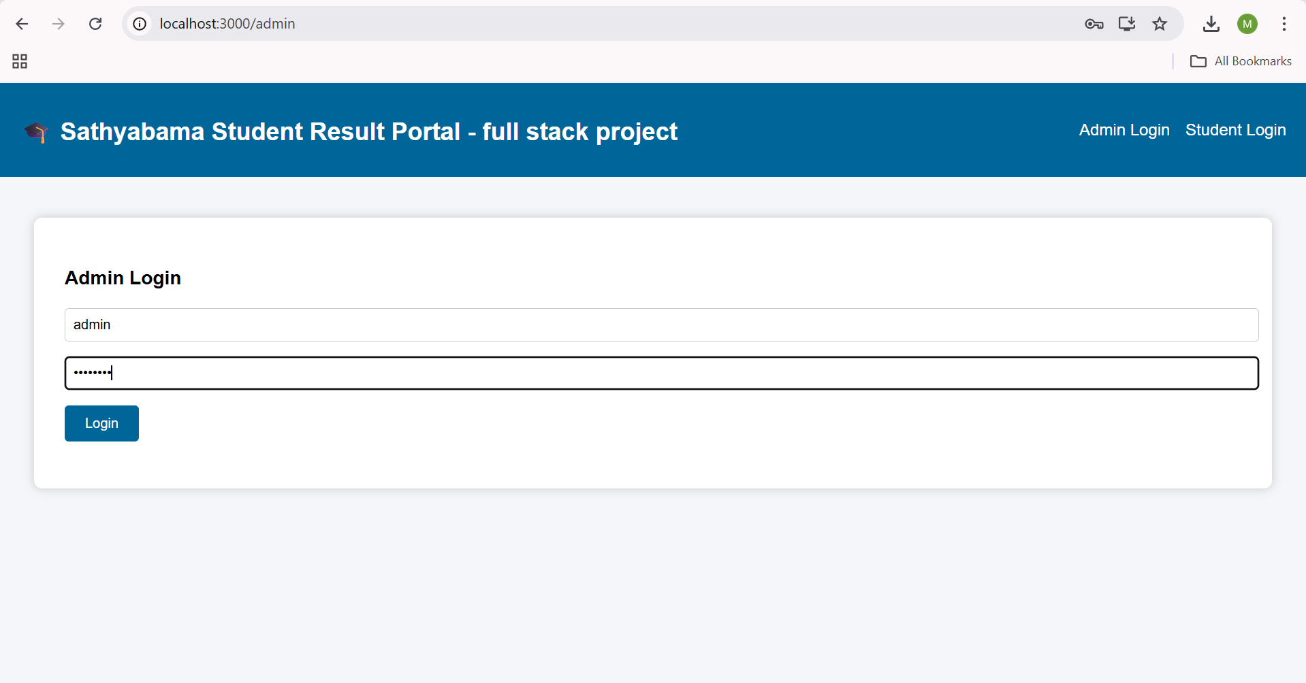
SAMPLE OUTPUT(SCREENSHOT)
Admin login portal

Slide 15
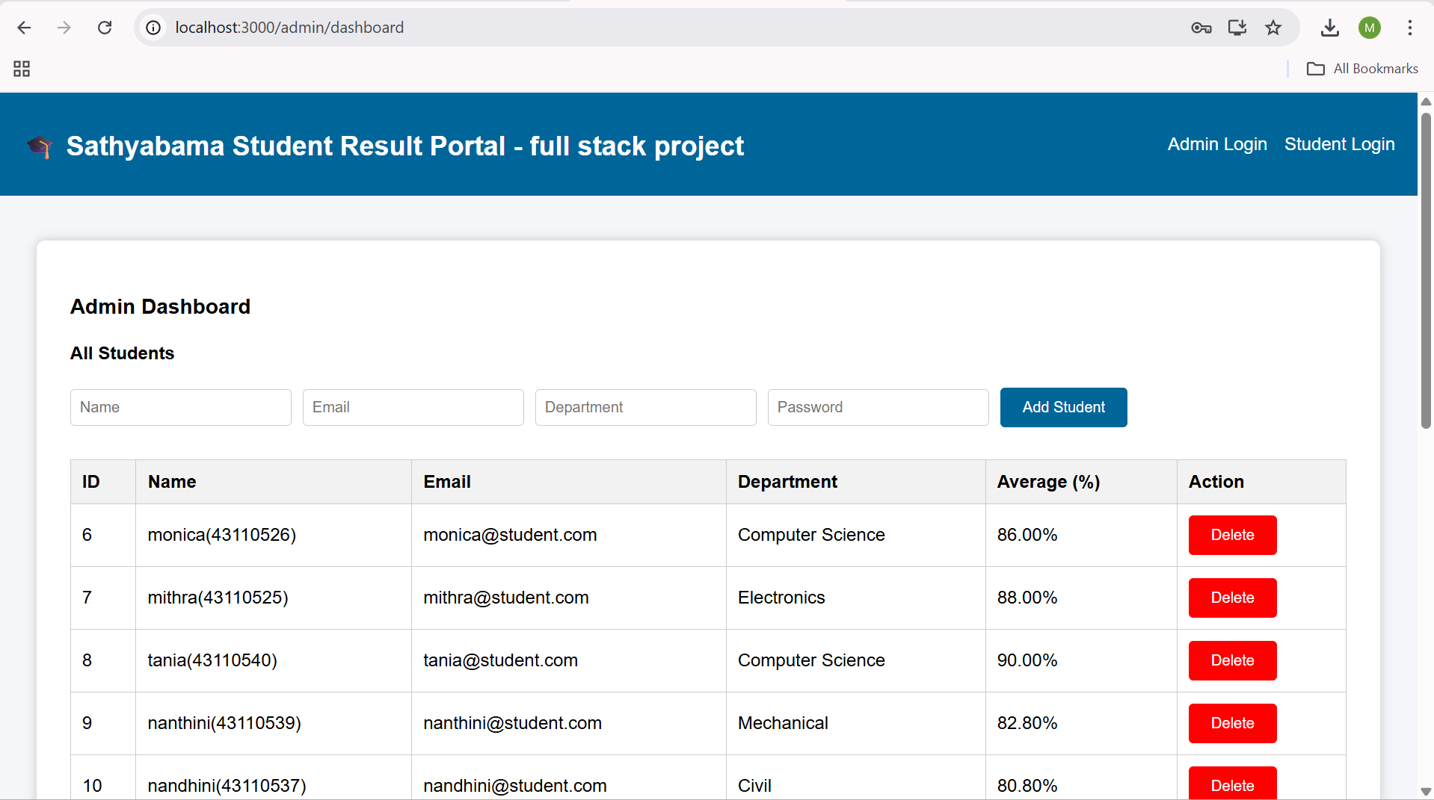
SAMPLE OUTPUT(SCREENSHOT)
Admin portal

Slide 16
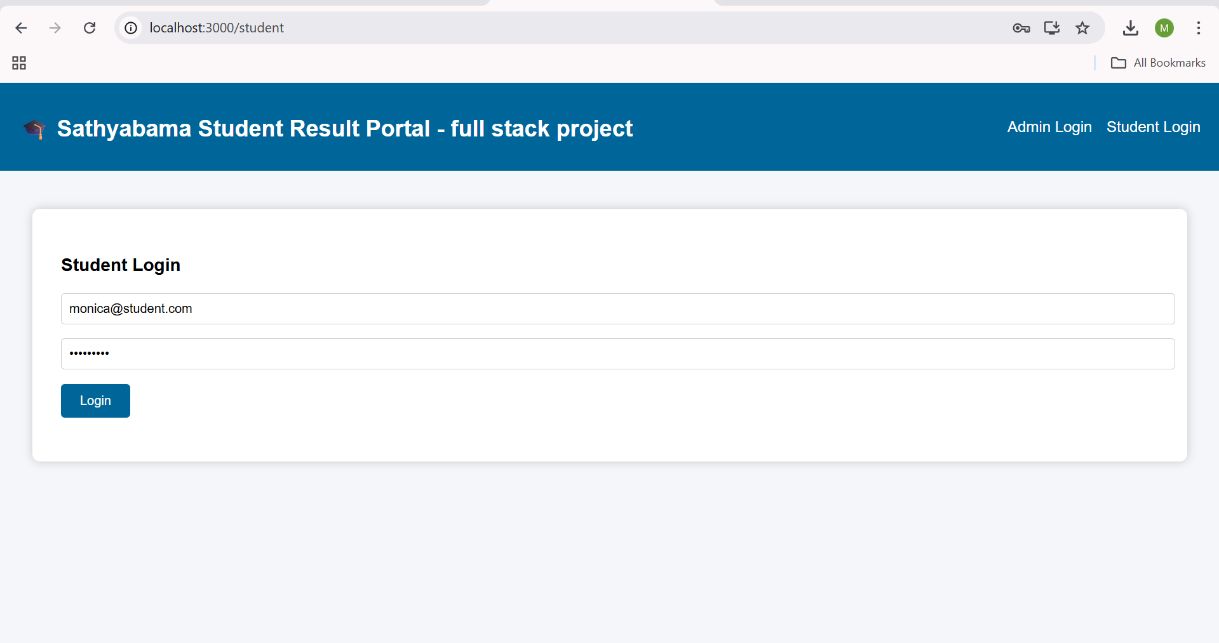
SAMPLE OUTPUT(SCREENSHOT)
Student login portal

Slide 17
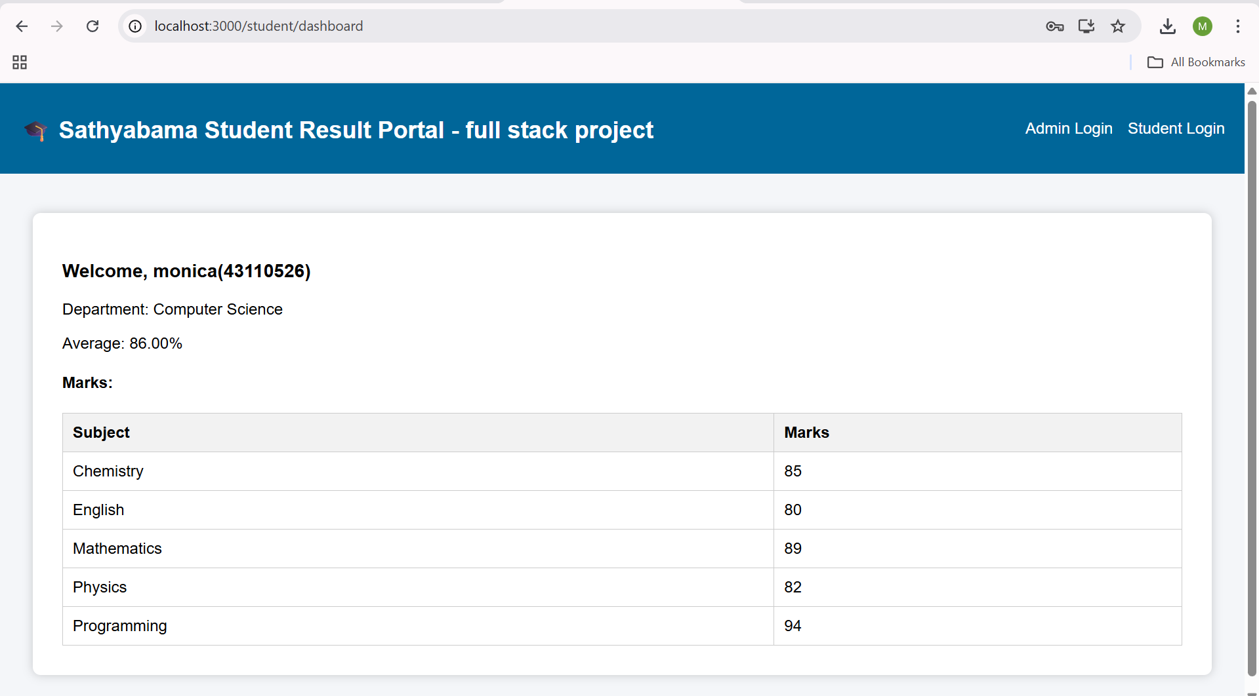
SAMPLE OUTPUT(SCREENSHOT)
Student Result portal

Slide 18
CONCLUSION
The Student Result Management System (SRMS) successfully automates the process of managing student results.
It ensures accuracy, efficiency, and transparency in result processing.
The integration of React.js, Spring Boot, and MySQL provides a powerful, scalable, and user-friendly platform.
Both admins and students benefit from real-time data access and secure system operations.
The project demonstrates how technology can simplify academic management and improve overall productivity.

Slide 19
THANK YOU
We thank God, Our Department, Guide, Panel Members, Supportive Professors and all Technical and non Technical staff who helped us in our Project.

